Slide 1

Bellabeat: Turning Smart Data into Growth
Marketing Strategy Recommendations based on Non-Bellabeat User Data
Presented By Nitin (Junior Data Analyst)
Date October 2025

Slide 2
What do we want to achieve?
To make Bellabeat a bigger player in the global smart device market .
Growth opportunities are found by analyzing non-Bellabeat smart device users (Fitbit data) .
Based on the analysis, a high-level marketing strategy guide is to be developed for Leaf and Time products .
Urška Sršen
(Cofounder & CCO)​

Slide 3
Data Source & Scope
FitBit Fitness Tracker Data (33 Users)
31 days of daily activity data (April-May 2016) sleep, and minute-level data were analyzed.
The data shows a clear trend: users' biggest challenge is balance and consistency , not just steps.

Slide 4
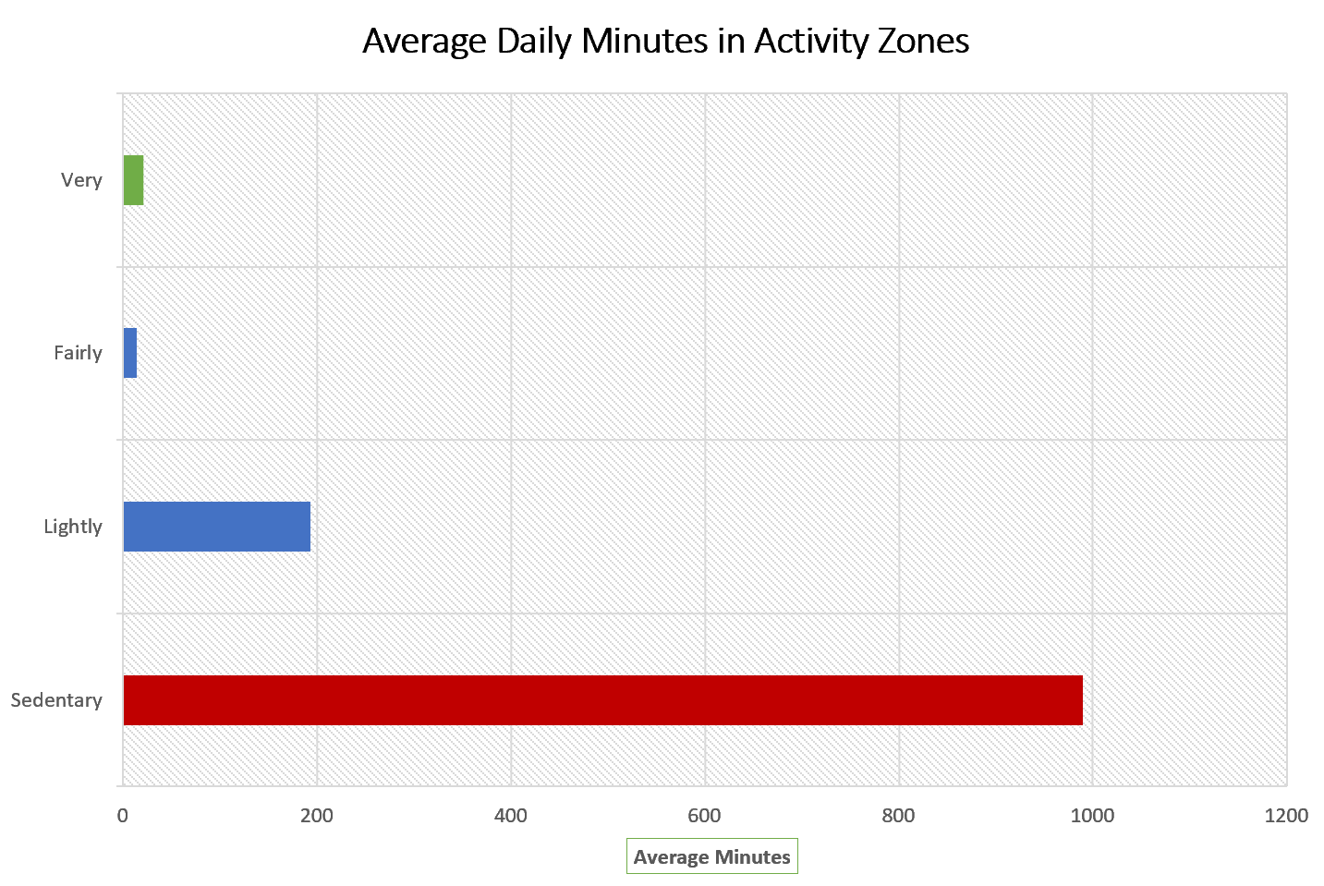
Insight 1: The 16.5 Hour Sedentary Challenge
The average user spends 989 minutes (≈16.5 hours) per day in the sedentary zone. High-intensity activity is negligible.
The Opportunity: Users need immediate habit-breaking features, not just tracking. This is a clear gap for Bellabeat to promote active reminders.

Slide 5
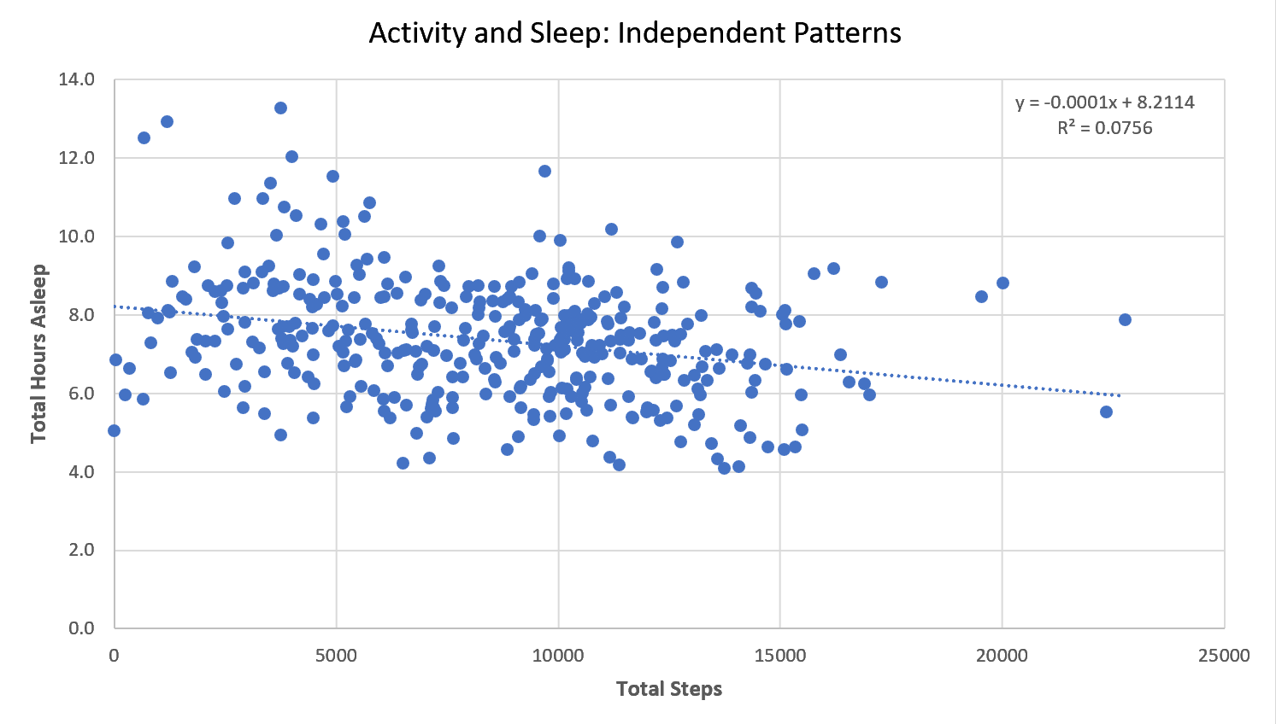
Insight 2: Activity and Sleep are Independent
The data shows a very weak correlation (R2≈0.07) between Steps and Sleep. As steps increase, sleep quality does not consistently improve.
The general market assumption (Walk More = Sleep Better) is flawed for this user base. The real drivers are Stress and Lifestyle.

Slide 6
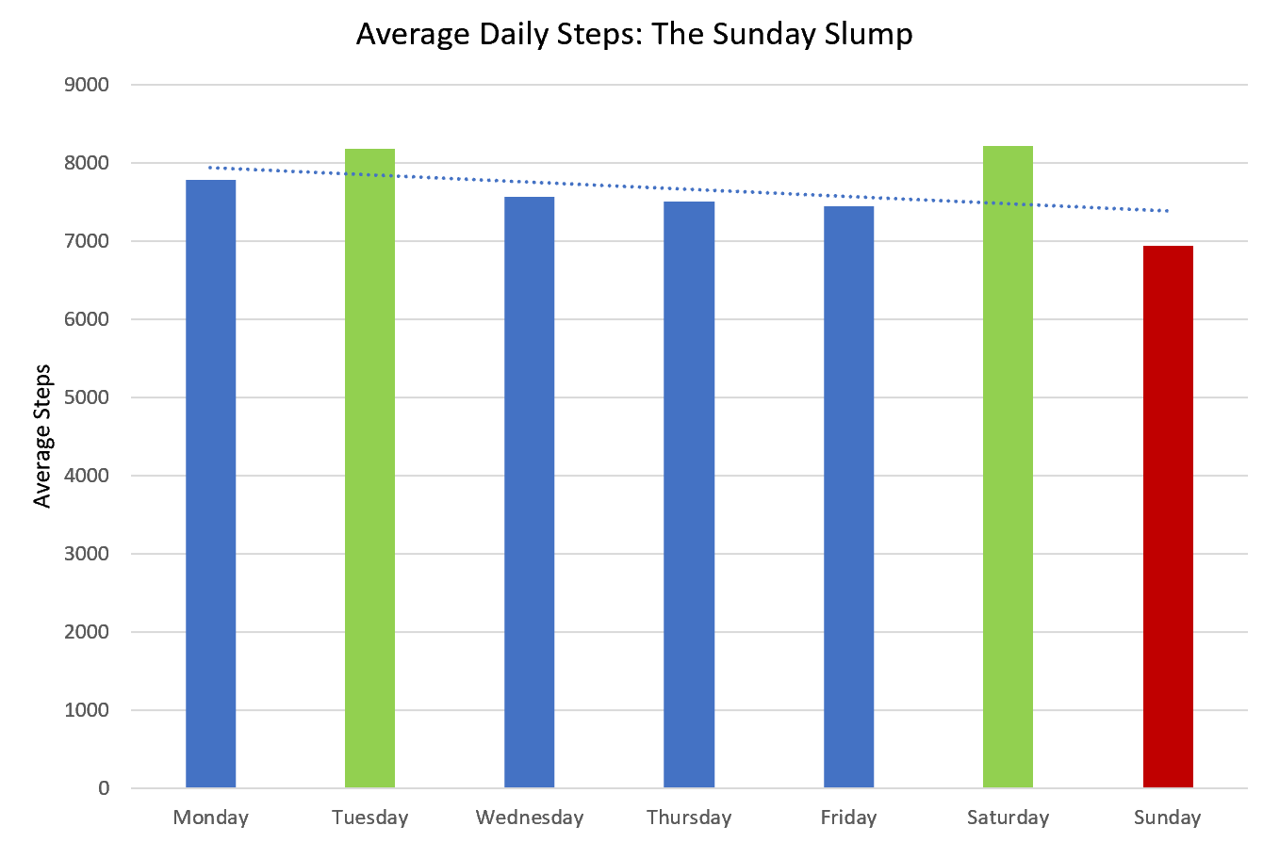
Insight 3: The Strategic Sunday Slump
User activity peaks on Saturday but drops to its lowest on Sunday. Activity tracking consistency is lacking on Sundays.
Sunday morning is the prime time for re-engagement—when users are least active and most likely to forget their device.

Slide 7
Recommendation 1: Embrace the 'Balance & Recovery' Narrative
Challenge the steps-only status quo. Position Leaf and Time as the solution to the Independence Problem found in the data.
Product Focus Stress, Sleep, and Reproductive Health Tracking.
"Track Your Balance: Your Steps Are Not the Full Story. Bellabeat Finds the Missing Link."

Slide 8
Recommendation 2: Maximize Sunday Engagement
Action Re-allocate digital budget to run high-impact video ads on YouTube/display ads on the Google Display Network every Sunday morning.
Content Push short, low-effort "Sunday Stroll" or "Active Recovery" challenges via the app and social media.
Goal Increase user consistency and combat the drop-off found in our trend analysis.

Slide 9
Recommendation 3: Upsell the Personalized Membership
The Imbalance and Sedentary crisis prove users need expert guidance. The Membership is the fix.
Market the Membership as the only way to solve the Independence Problem with personalized guidance on nutrition, activity, and sleep.
Membership Message: "Stop Guessing, Start Optimizing."

Slide 10
Summary: Clear Actions for Growth
High Sedentary Time (16.5 hrs)
Activity/Sleep Independence
Sunday Campaign Timing
Top Action
Shift marketing from steps to balance and recovery across all channels (Google Search, Instagram, etc.)
Selected Product
Leaf and Time—because they track the complete picture (Activity, Sleep, Stress).

Slide 11
Next Steps: Validating the Strategy
A/B Test Campaign Timing: Immediately test Sunday vs. Monday morning ad performance.
Content Review: Increase marketing focus on stress management and mindfulness content.
Data Validation: Explore additional public health data to validate the correlation between activity and stress/sleep.
Thank You

